Slide 1
Introduction to agriculture and climate
Beiyu Lin

Slide 2
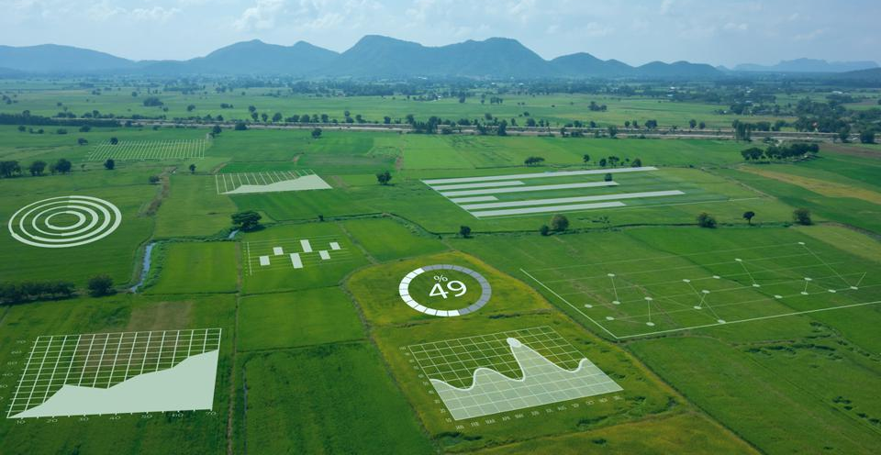
iOT—NABLED AGRICULTURAL MONITORING
Notes:
smart, connected agriculture

Slide 3
Why smart agriculture
The world's population will increase by 2 billion people by 2050, requiring a 60% increase in food productivity to feed them

Slide 4
Why smart agriculture
Global warming: Earth's temperature has risen by 0.14° F (0.08° C) per decade since 1880, and the rate of warming over the past 40 years is more than twice that: 0.32° F (0.18° C) per decade since 1981. 2020 was the second-warmest year on record based on NOAA's temperature data

Slide 5
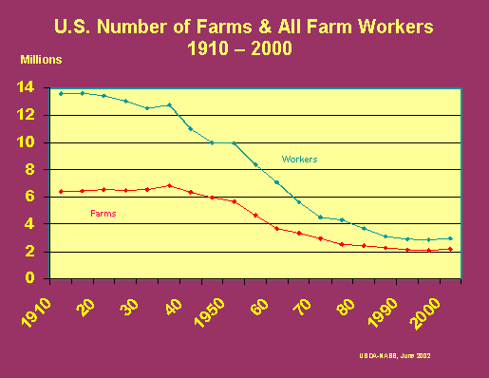
Why smart agriculture
Labor shortage of farm workers

Slide 6
Why smart agriculture
The world's population will increase by 2 billion people by 2050, requiring a 60% increase in food productivity to feed them
Global spending on smart, connected agricultural technologies and systems, including AI and machine learning, is projected to triple in revenue by 2025, reaching $15.3 billion
Spending on AI technologies and solutions alone in Agriculture is predicted to grow from $1 billion in 2020 to $4 billion in 2026, attaining a Compound Annual Growth Rate (CAGR) of 25.5%
IoT-enabled Agricultural (IoTAg) monitoring is smart, connected agriculture's fastest-growing technology segment projected to reach $4.5 billion by 2025

Slide 7
AGRICULTURE
Agriculture Tasks
Pre-harvesting
harvesting
Post-harvesting
Notes:
https://bmcmedicine.biomedcentral.com/articles/10.1186/s12916-019-1426-2

Slide 8
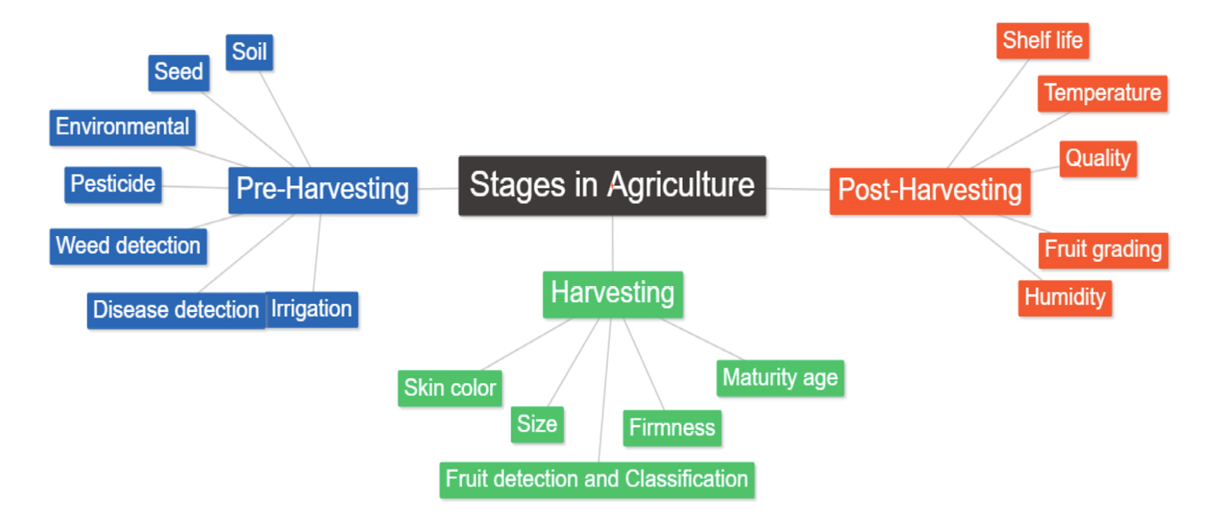
AGRICULTURE

Slide 9
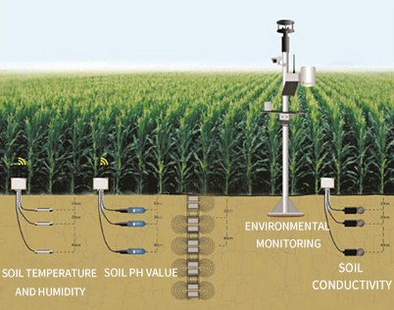
How it works out
Overview (youtube link 0:30 – 2:17)
Improve crop yields
Reduce food production costs
IOT: sensors provide real-time data
Link: 0:37- 1:34

Slide 10
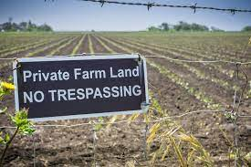
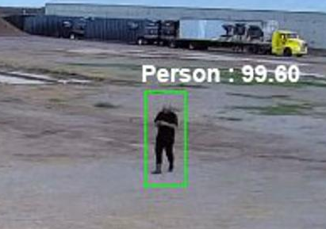
How it works out
IOT sensors provide real-time data (youtube link 0:30 – 2:17)
Improve crop yields
Reduce food production costs
Video: use AI/ML to surveil and monitor every crop field’s real-time
Monitor / Identify animal or human breaches (link 0:10- 1:13)
-- send alert

Slide 11
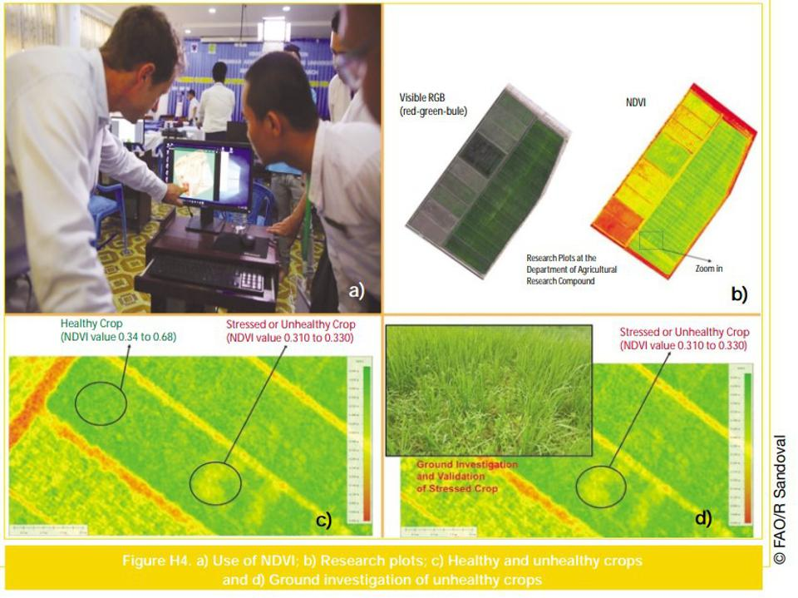
How it works out
Drone: use AI/ML to surveil and monitor every crop field’s real-time
Smart sensors and drones: video streaming
Combine in-ground sensor data of moisture, fertilizer and natural nutrient levels
Analyze growth patterns of each crop
Link: 1:11-3:34

Slide 12
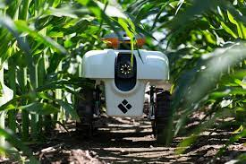
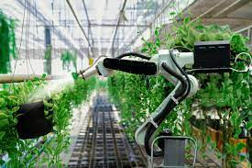
How it works out
Robots for Agriculture ( 7 agriculture robots)
Link: 0:22 – 0:59

Slide 13
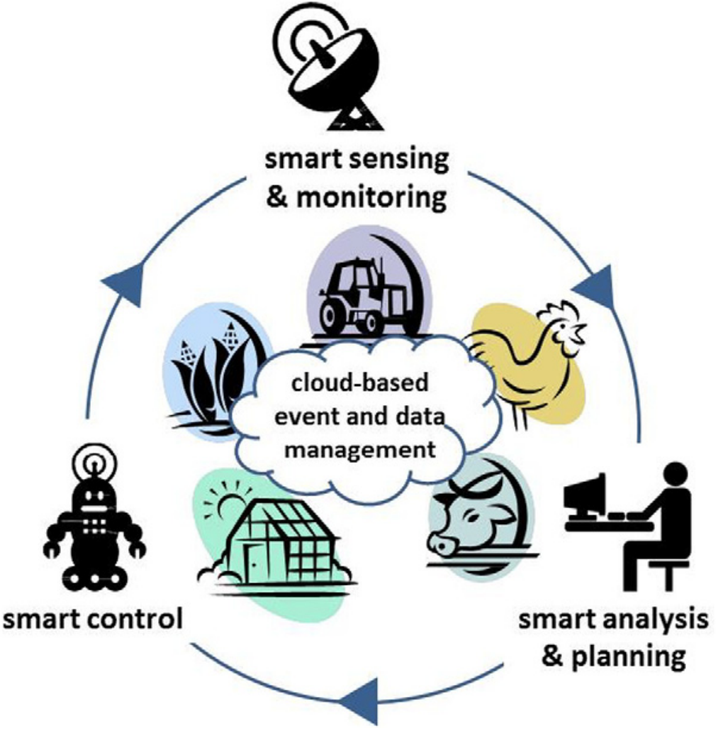
Data Type
IOT sensor data
Image data
Video data

Slide 14
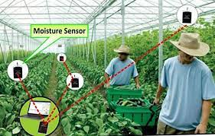
CHALLENGES
IOT sensor data
Temperature
Humidity
Light
Pressure
Noise
Speed
Direction
Size & Weight
Noisy: missing values; jitters; sensor failures

Slide 15
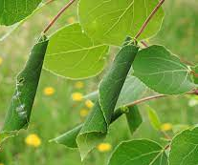
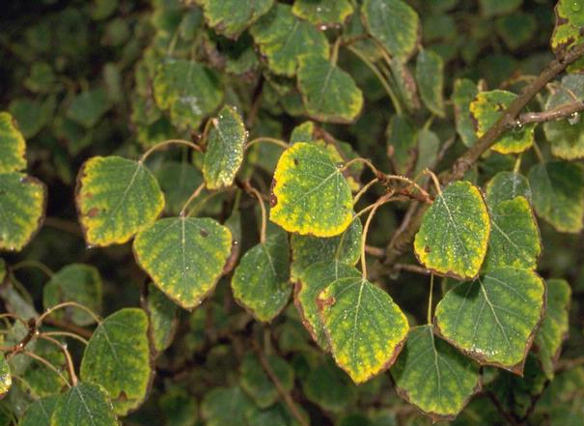
CHALLENGES
Image data and video data:
Plant recognition / classification (compare color / shape of leaves)
Notes:
Pests or mud

Slide 16
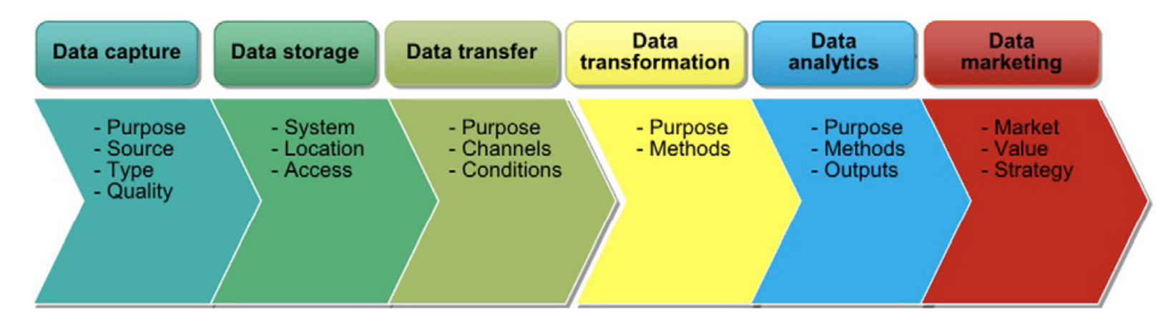
Data chain
Availability,
quality,
formats
Quick
Safe
Access to data
Safety,
Agreements on
responsibilities
Automation of
Data cleansing,
preparation
Real-time analytics;
Scalability
Ownership,
Privacy,
New business models

Slide 17
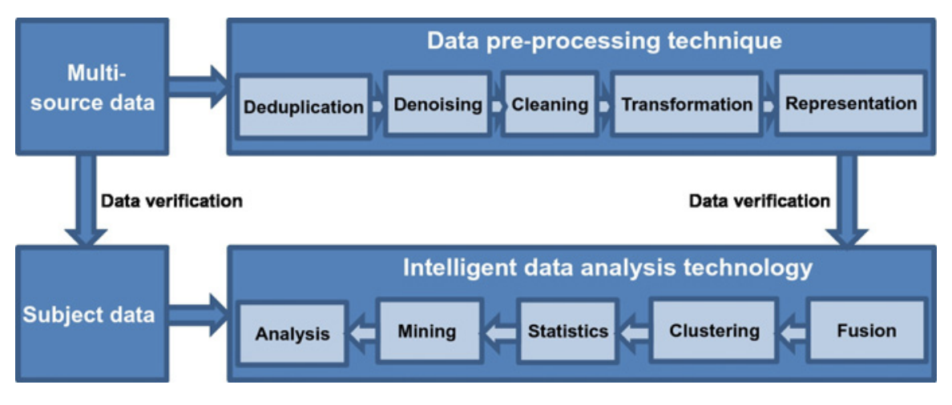
Data processing

Slide 18
Research topics
Fuse / combine multi-source data
Real-time decision making
Small samples
Missing values
Feature design and extractions

Slide 19
Research topics
Fuse / combine multi-source data

Slide 20
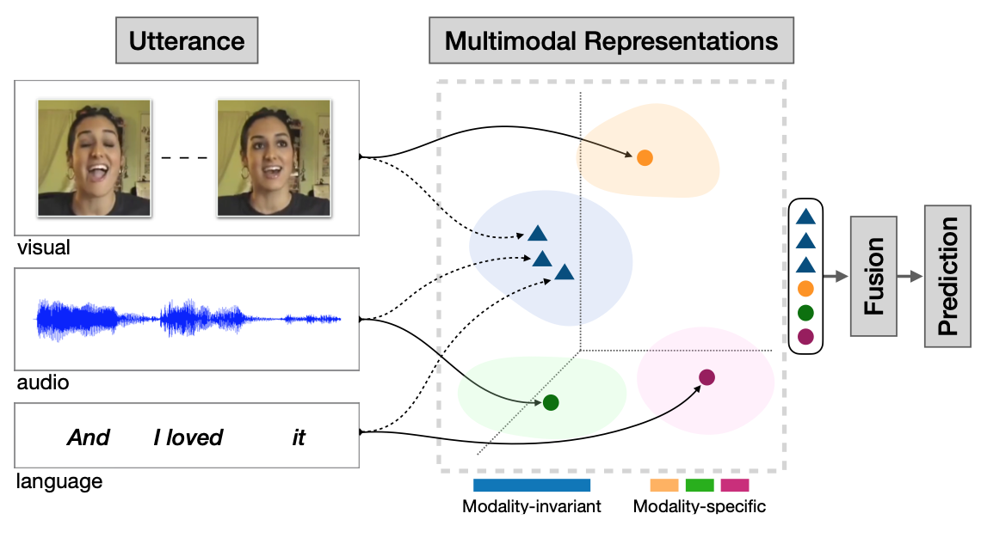
What is multi-source data

Slide 21
Multimodality Data Fusion
Early fusion / data-level fusion
Late fusion / decision-level fusion
Intermediate fusion

Slide 22
Early fusion
Fusing multiple data before conducting the analysis
Fuse at the input level
Approaches
Combining data by removing the correlation between two sensors
Fusing data at its lower dimensional common space
Statistical solutions:
Principal component analysis (PCA)
Canonical correlation analysis
Independent component analysis

Slide 23
Early fusion
Note:
Applied to: raw or pre-processed sensor data
Extract features before fusion
Challenging:
Synchronization of data source:
E.g., one data source is discrete and the others are continuous
Converting data into a single feature vector

Slide 24
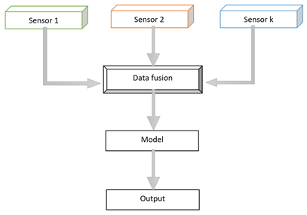
Early fusion
Assumption of early data fusion:
Multiple data sources are conditional independent.
Would this be always true?
If not, example(s)?
Video

Slide 25

Early fusion
Methods:
Concatenate features in a multimodal stream
Simplest form of an early-stage data fusion
Any concerns?

Slide 26
Early fusion
Methods:
Concatenate features in a multimodal stream
Simplest form of an early-stage data fusion
Concerns / disadvantages:
1. A large amount of data will be deducted to make a common ground before fusion
2. Synchronizing the timestamp of the different modalities
solution: collect data / signals at a common sampling rate.

Slide 27
Early fusion
Other Methods:
Training, pooling, and convolution fusion.
More information: H. P. Martínez and G. N. Yannakakis, “Deep Multimodal Fusion,” 2014

Slide 28
Multimodality Data Fusion
Early fusion / data-level fusion
Late fusion / decision-level fusion
Intermediate fusion

Slide 29
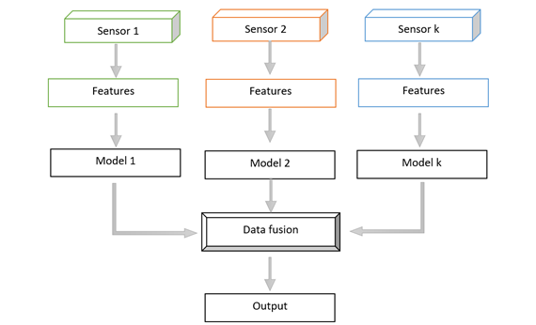
Late fusion / decision level fusion
Use data sources independently followed by fusion at a decision-making stage

Slide 30
Late fusion / decision level fusion
Use data sources independently followed by fusion at a decision-making stage
Methods to finally combine each of the independently trained models:
Bayes rules
Max-fusion
Average-fusion

Slide 31
Late fusion / decision level fusion
Pros and cons:
Good for data sources varies (e.g., different sampling rate, data dimensionality, and unit of measurement).
Offer better performance
Why?
errors from multiple models are dealt with independently
— thus error are uncorrelated

Slide 32
Multimodality Data Fusion
Early fusion / data-level fusion
Late fusion / decision-level fusion
Intermediate fusion

Slide 33
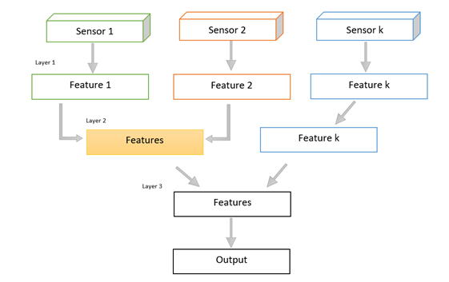
Intermediate fusion

Slide 34
Intermediate fusion
Based on deep neural network
Fuse different modalities representations / features into a single hidden layer
The model learns a joint representation / feature of each of the modalities.
Changes input data into a higher level of representation/ features through multiple layers
Each individual layer operates linear and nonlinear functions
To transform the input data’s scale, skew and swing
To give a new representation of the original input data

Slide 35
Intermediate fusion
Features can be learned from different kinds of layers including:
2D convolution; 3D convolution and fully connected
The layer where the fusion of different modality features happened – called
A fusion layer or a shared representation / feature layer

Slide 36
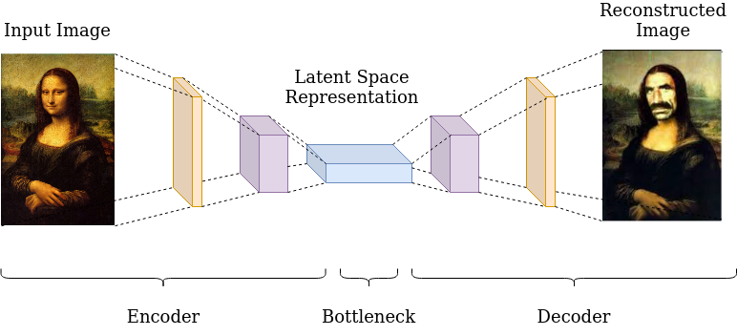
Intermediate fusion
Method to improve deep multimodal fusion performance
Reduce dimensionality of the data (PCA, autoencoders)
how to use autoencoders: after constructing a fusion layer or shared representation layer,
reduce the dimensionality of the network.

Slide 37
Intermediate fusion
Pros and Cons:
Most flexible method: allows for data fusion at different stages of model training
NN based multimodal data fusion has greatly improved performance.
Overfitting problem if fusing multiple modality features / weights in a single layer

Slide 38
Intermediate fusion
Other methods:
“slow-fusion” network:
video stream features are gradually fused across multiple fusion layers
Good for a large-scale video stream classification
Fuse highly correlated input modalities first and less correlated ones progressively after
E.g., visual input modalities first, then motion input modal, then audio input modalities

Slide 40
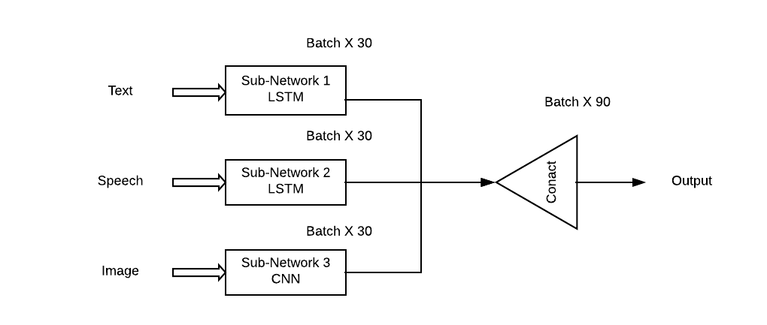
Fuse / combine multi-source data

Slide 41
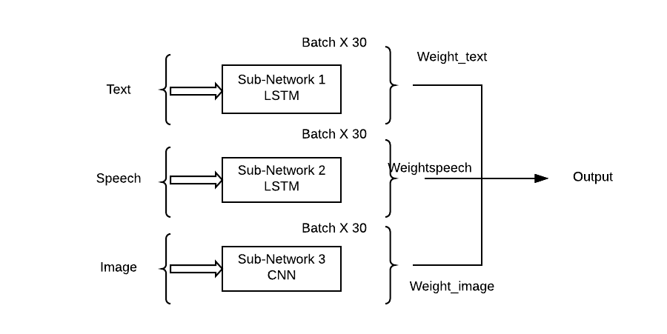
Fuse / combine multi-source data

